Slide 1
هوش محاسباتی:
شبکه های عصبی مصنوعی
دانشكده مهندسي كامپيوتر
دانشگاه علم و صنعت ايران
mozayani@iust.ac.ir
مدل پرسپترون

Slide 2
Artificial Intelligence by Neural Net
We hope to obtain a better A.I. by simulating Neural Networks…. A dream?...
After all, we try to understand more about human brain
and to gradually construct an artificial brain.

Slide 3
A preliminary definition
A Neural Network is :
an interconnected assembly of simple processing elements, units or nodes, whose functionality is loosely based on the animal neuron
The processing ability of the network is stored in the inter-unit connection strengths, or weights, obtained by a process of adaptation to, or learning from, a set of training patterns

Slide 4
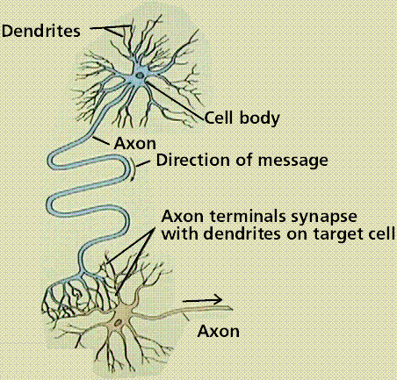
A biological neuron

Slide 5
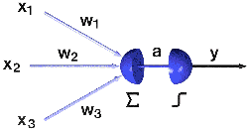
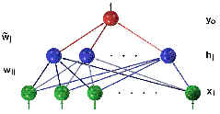
An Artificial neuron

Slide 6
Conventional computers vs. Neural nets
In a von Neumann machine:
-fetch
-decode
-execute
-…
In a Neural Net:
-different style of processing (signal processor)
-massively parallel processor
-information is stored in a set of weights (memory)
-robust to noise and hardware failure
-…
CPU
data
Instructions
& data
Memory

Slide 7
Conventional computes vs. Neural nets
In a Neural Net:
  Switching time ~ .001 second
  Scene recognition time ~ 0.1 second
  How many instructions in a CPU ?

Slide 8
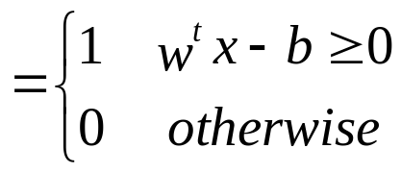
Definition
the basic model : an artificial neuron
Warren McCulloch & Walter Pitts (1943)
x₁
1
weights
w₀
b
threshold
x₂
w₁
w₂
Σ
x₃
.
.
.
w₃
w^{t}x
b
w_{n}
H(w^{t}x - b)
x_{n}
activation

Slide 9
Function
geometry: linear separation boundary
w
b/w₂
b/w₁

Slide 10
Task
learn a binary classification f:ℝ^{n}→{0,1}
given examples (x,y) in ℝ^{n}x{0,1}, positive/negative examples
evaluation: mean number of misclassifications on a test set

Slide 11
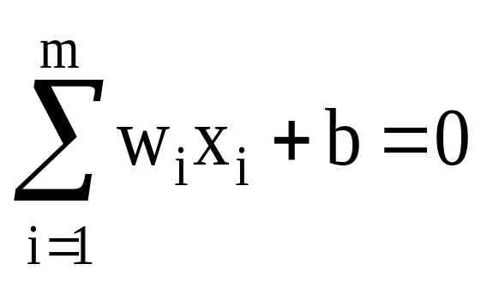
Linear Classification
The equation below describes a hyperplane in the input space. This hyperplane is used to separate the two classes C1 and C2
decision
region for C1
x₂
w₁x₁ + w₂x₂ + b > 0
decision
boundary
C₁
decision
region for C₂
x₁
C₂
w₁x₁ + w₂x₂ + b <= 0
w₁x₁ + w₂x₂ + b = 0

Slide 12
Artificial Neuron
Using an activation function and a threshold, the neuron can implement a simple logic function:
Example: AND function
x₁ | x₂ | y
0 | 0 | 0
0 | 1 | 0
1 | 0 | 0
1 | 1 | 1
1
X₁
y
Threshold = 1.5
X₂
1

Slide 13
Artificial Neuron
Example 2: OR function
x₁ | x₂ | y
0 | 0 | 0
0 | 1 | 1
1 | 0 | 1
1 | 1 | 1
2
X₁
y
Threshold = 1.5
X₂
2

Slide 14
Artificial Neuron
Example 3: AND NOT function
x₁ | x₂ | y
0 | 0 | 0
0 | 1 | 0
1 | 0 | 1
1 | 1 | 0
2
X₁
y
Threshold = 1.5
X₂
-1

Slide 15
Perceptron
Rosenblatt 1958
  Adopted from visual perception in human
  Pattern classification
B
w₁
w₂
Σ
B
w₃
θ
...
w_{n}

Slide 16
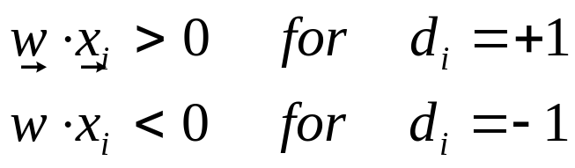
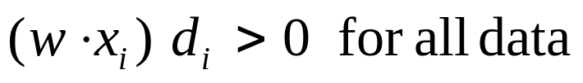
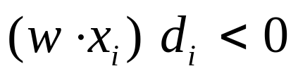
Perceptron Learning
Training data input / target pairs (e.g. green points are +1 target, and red points are -1 target) { x_{i} , d_{i} }
We want that:
this is equivalent to:
A given data example will be misclassified if:

Slide 17
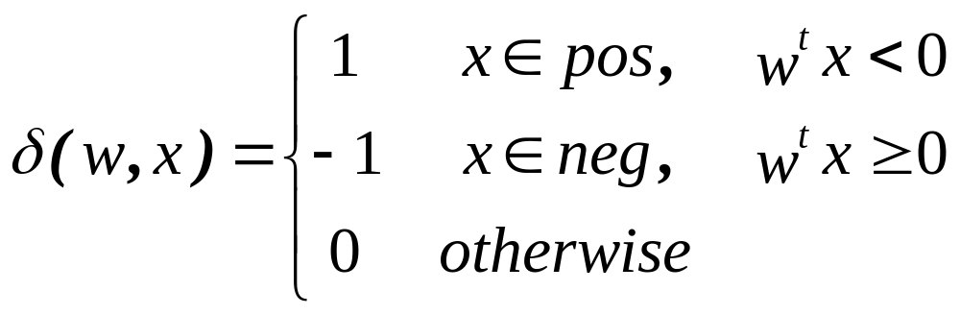
Perceptron learning rule
simulate the bias as on-neuron
define the error signal
init w;
repeat while some x with δ(w,x)≠0 exists:
w := w + δ(w,x)∙x;
This is a Hebbian learning

Slide 18
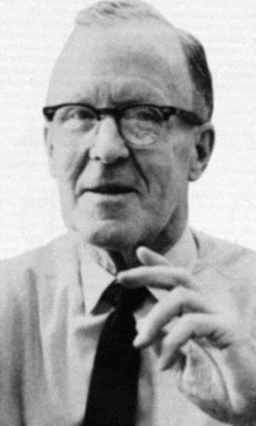
Hebb rule
Hebbian learning: (Donald.O.Hebb, 1949, Psychologist)
increase the connection strength for similar signals and decrease the strength for dissimilar signals
input | output | weight
+ | + | +
- | + | -
+ | - | -
- | - | +
weight adaptation for the perceptron learning rule for misclassified examples:
w := w + δ(w,x)∙x;

Slide 19
Donald Hebb
Made four major contributions:
* Recognized that information is stored in the weight of the synapses
* Postulated a learning rate that is proportional to the product of neuron activation values
* Assumed weights are symmetric
* Postulated a cell assembly theory: Repeated simultaneous activation of weakly-connected cell group results in a more strongly connected group

Slide 20
The fixed-increment learning algorithm
Initialization: set w(0) =0
Activation: activate perceptron by applying input example (vector x(n) and desired response d(n))
Compute actual response of perceptron:
y(n) = sgn[w^{T}(n)x(n)]
Adapt weight vector: if d(n) and y(n) are different then
w(t + 1) = w(t) + η[d(n)-y(n)]x(n)
Learning rate
δ(w,x)
+1 if x(n) ∈ C₁
Where d(n) =
-1 if x(n) ∈ C₂
Continuation: increment time step n by 1 and go to Activation step

Slide 21
Perceptron - theory
For a solvable training problem:
the perceptron algorithm converges,
the number of steps can be exponential,
alternative formulation: linear programming (find x which solves Ax≤b) → polynomial algorithms exist
generalization ability: scales with the input dimension
Only linearly separable problems can be solved with the perceptron → linear classification boundary.

Slide 22
Limitations of the Perceptron
Problems which are not linearly separable:
e.g. XOR
the convergence is not assured
the perceptron algorithm cannot find a solution, but a cycle will be observed (perceptron-cycle theorem, i.e. the same weight will be observed twice during the algorithm)
a solution as good as possible is found if the examples are chosen randomly after some time → pocket algorithm: store the best solution (Gallant 1990)
finding an optimum solution in the presence of errors is NP-hard (can even not be approximated with respect to any given constant)

Slide 23
Limitations of the Perceptron
    If the problem is linearly separable, there may be a number of possible solutions.
    The algorithm as stated gives no indication of the quality of the solution found

Slide 24
Perceptron - history
43: McCulloch/Pitts: propose artificial neurons and show the universal computation ability for circuits of neurons
49: Hebb paradigm proposed
58: Rosenblatt-perceptron (First practical application of ANN) fixed preprocessing with masks, learning algorithm, used for picture recognition
60: Widrow/Hoff: ADALINE (ADAptive Linear Neuron)
    Rosenblatt and Hoff proposed multilayer perceptron
      But, not able to modify learning algorithms to train it
69: Minsky/Papert: show the restrictions of the Rosenblatt-perceptron with respect to its representational abilities
86: Rumelhart/McClelland
    Train multilayer perceptron successfully!

Slide 25
Adaline
ADALINE is an acronym for ADAptive LINear Element (or ADAptive LInear NEuron) developed by Bernard Widrow and Marcian Hoff (1960).
Variation on the Perceptron Network
  The output y is a linear combination o x
  inputs are +1 or -1, outputs are +1 or -1
  uses a bias input
There are several variations of Adaline. One has threshold same as perceptron and another just a bare linear function, etc

Slide 26
Adaline
Differences:
  Weights update is a function of output error
  trained using the Delta Rule
    also called: Gradient Descent method, Steepest Descent Method , LMS rule (least mean square), Adaline rule, Widrow-Hoff rule (the inventors)
  The step function in the perceptron can be replaced with a continuous (differentiable) function f, e.g the simplest is linear function
  In the case of a hard limiter as the activation function, it is not used during training (i.e.The Delta Rule applies to a Perceptron without a threshold).

Slide 27
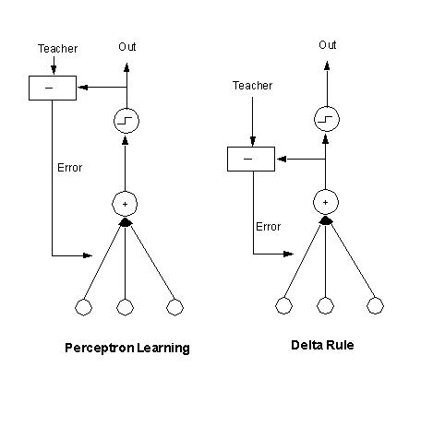
Adaline
- With or without the threshold, the Adaline is trained based on the output of the function f rather than the final output.
f (x)
Perceptron learning
Delta Rule

Slide 28
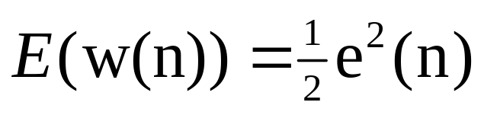
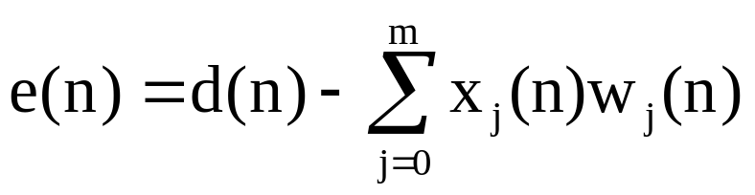
Learning algorithm
  The idea: try to minimize the network error (which is a function of the weights)
  So we have to:
    Define an error measure
    Determine the gradient of error wrt changes in weights
    Define a rule for weight update
We can find the minimum of the error function E by means of the Steepest descent method

Slide 29
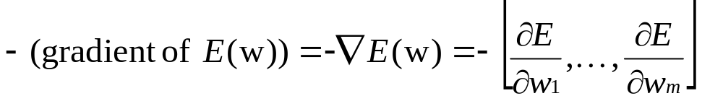
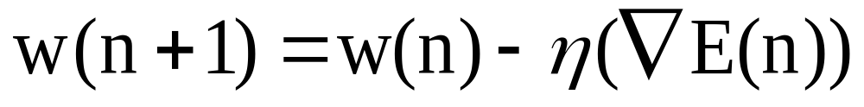
Gradient Descent Method
start with an arbitrary point
find a direction in which E is decreasing most rapidly
make a small step in that direction

Slide 30
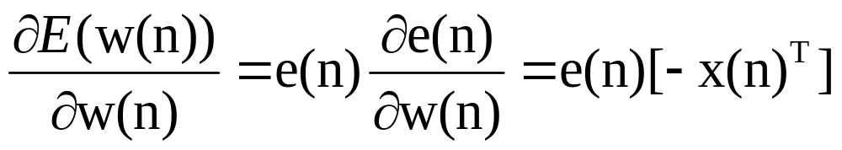
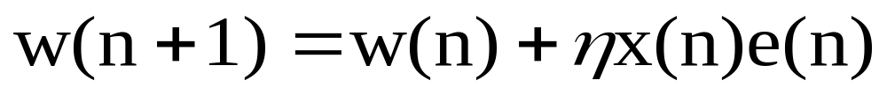
Gradient Descent Algorithm
Approximation of gradient(E)
Update rule for the weights becomes:

Slide 31
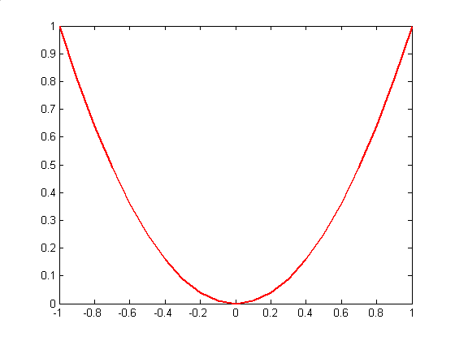
Gradient Descent
Gradient direction is the direction of uphill
for example, in the Figure, at position 0.3, the
gradient is uphill ( F is Error, consider 1-dim case )
F
Gradient
direction
F’(0.3)

Slide 32
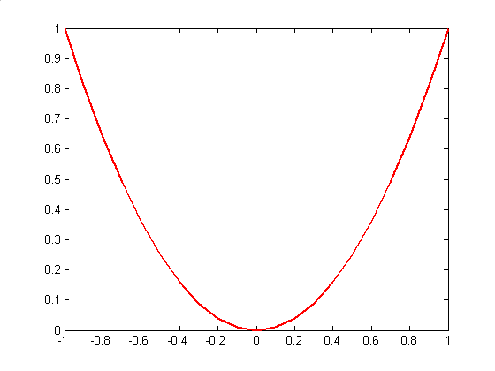
Gradient Descent
In gradient descent algorithm, we have
w(t+1) = w(t) –η ∇E(w(t))
therefore the ball goes downhill since –∇E(w(t))
is downhill direction
w(t)

Slide 33
Gradient Descent
In the next step the ball goes again
downhill since –∇E(w(t)) is downhill direction
w(t+1)

Slide 34
Gradient Descent
Gradually the ball will stop at a local minima where
the gradient is zero
w(t+k)

Slide 35
Learning Algorithm
Step 0: initialize the weights to small random values and select a learning rate, η
Step 1: for each input vector s, with target output, t set the inputs to s
Step 2: compute the neuron inputs
Step 3: use the delta rule to update the bias and weights
Step 4: stop if the largest weight change across all the training samples is less than a specified tolerance, otherwise cycle through the training set again
Neuron input
Delta rule
Σ
b(new) = b(old) + η(d - y)
w_{i}(new) = w_{i}(old) + η(d - y)x_{i}
y = b + x_{i}w_{i}

Slide 36
Running Adaline
One unique feature of ADALINE is that its activation function is different for training and running
When running ADALINE use the following:
  initialize the weights to those found during training
  compute the net input
  apply the activation function
Neuron input
Activation Function
Σ
{
1 if y >= 0
y = b + x_{i}w_{i}
y =
-1 if y < 0

Slide 37
Example – AND function
Construct an AND function for a ADALINE neuron
  let α = 0.1
1
b
x₁
w₁
Σ
0
x1 x2 bias Target
1 1 1 1
1 -1 1 -1
-1 1 1 -1
-1 -1 1 -1
w₂
x₂
Initial Conditions: Set the weights to small random values:
1
0.1
x₁
0.2
Σ
0
0.3
x₂

Slide 38
First Training Run
Apply the input (1,1) with output 1
The net input is:
y = 0.1 + 0.2*1 + 0.3*1 = 0.6
1
The new weights are:
The largest weight change
is 0.04
0.1
b = 0.1 + 0.1(1-0.6) = 0.14
w₁ = 0.2 + 0.1(1-0.6)1 = 0.24
w₂ = 0.3 + 0.1(1-0.6)1 = 0.34
1
0.2
Σ
0
1
0.3
1
Neuron input
Delta rule
Σ
y = b + x_{i}w_{i}
b(new) = b(old) + η(d - y)
w_{i}(new) = w_{i}(old) + η(d - y)x_{i}

Slide 39
Second Training Run
Apply the second training set (1 -1) with output -1
The net input is:
y = 0.14 + 0.24*1 + 0.34*(-1) = 0.04
The new weights are:
The largest weight change
is 0.1
1
b = 0.14 - 0.1(1+0.04) = 0.04
w₁ = 0.24 - 0.1(1+0.04)1 = 0.14
w₂ = 0.34 + 0.1(1+0.04)1 = 0.44
0.14
1
0.24
Σ
0
-1
0.34
-1

Slide 40
Third Training Run
Apply the third training set (-1 1) with output -1
The net input is:
y = 0.04 - 0.14*1 + 0.44*1 = 0.34
The new weights are:
1
The largest weight change
is 0.13
b = 0.04 - 0.1(1+0.34) = -0.09
w₁ = 0.14 + 0.1(1+0.34)1 = 0.27
w₂ = 0.44 - 0.1(1+0.34)1 = 0.31
0.04
-1
0.14
Σ
0
-1
0.44
1

Slide 41
Fourth Training Run
Apply the fourth training set (-1 -1) with output -1
The net input is:
y = -0.09 - 0.27*1 - 0.31*1 = -0.67
The new weights are:
The largest weight change
is 0.16
b = -0.09 - 0.1(1+0.67) = -0.27
w₁ = 0.27 + 0.1(1+0.67)1 = 0.43
w₂ = 0.31 + 0.1(1+0.67)1 = 0.47
1
-0.09
-1
0.27
Σ
0
-1
0.31
-1

Slide 42
Result
Continue to cycle through the four training inputs until the largest change in the weights over a complete cycle is less than some small number (say 0.01)
In this case, the solution becomes
  b = -0.5
  w₁ = 0.5
  w₂ = 0.5

Slide 43
Stochastic gradient descent
-Because there is only a single global minimum, the G.D.
will converge to the minimum error point on the surface,
independently of whether the training examples are linearly
separable.
There can be problems with Gradient Descent -
a) Convergence to a local minimum can be slow (e.g. 1000s
of steps).
b) If there are many local minima on the error surface, then
there is no guarantee that the global minimum is found.

Slide 44
Stochastic Gradient Descent
Problem of local minima
Error
W
Local
minimum
Local
minimum
Global
minimum

Slide 45
Stochastic G.D.
- An alternative to the Gradient Descent algorithm is to use an
incremental approach or “stochastic gradient descent” (called also Sequential mode, on-line, or per-pattern)
- instead of summing over ALL the training examples in training set, to compute the weight updates, it approximates gradient descent by updating weights incrementally, i.e. the weight is updated after the presentation of EACH training example, i.e.
Δw_{i} = η(d - y)X_{i}
- Stochastic gradient descent can be viewed by considering
an error function for each training example “k”.
E_{k}([W]) = 1/2 (d_{k} - y_{k})²

Slide 46
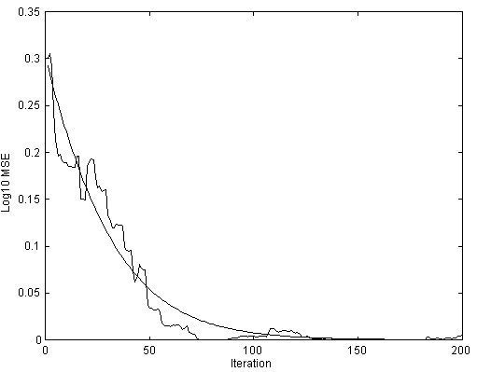
Stochastic G.D.

Slide 47
Stochastic G.D.
If the training rate is small enough, the stochastic gradient descent provides a reasonable approximation of the gradient descent algorithm .
Differences between G.D and stochastic G.D :
  In g.d., the error is summed over all examples before the
weights are updated. In S.G.D., the weights are updated after each training example.
  G.D. takes more computation per weight update step
  the gradient is accurate, so a larger step size can be used.
  When there are many local minima on the error surface,
S.G.D can often avoid them, due to the gradient being
found from E(w).

Slide 48
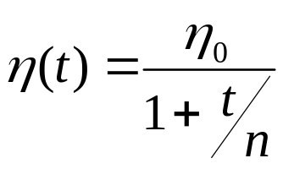
The Learning Rate, η
The performance of an ADALINE neuron depends heavily on the choice of the learning rate
  if it is too large the system will not converge
  if it is too small the convergence will take to long
Typically, η is selected by trial and error
  typical range: 0.01 < η < 10.0
  often start at 0.1
  sometimes it is suggested that:
  0.1 < n*η < 1.0 (where n is the number of inputs)
  Sometimes it is a fixed value, or a decreasing parameter:

Slide 49
Madaline
Several Adaline in parallel give a Madaline
x₁
x₂
Σ
x₃
.
.
.
x_{n}
W=1
AND
x₁
Threshold =
No on neurons
x₂
Σ
x₃
x_{n}

Slide 50
Madaline
Separable regions:

Slide 51

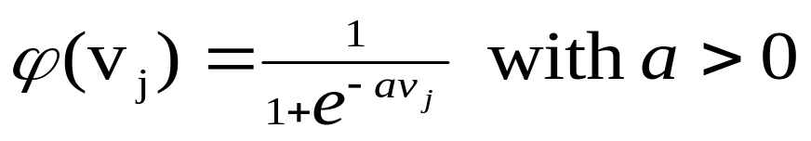

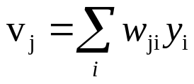
Other points
Choice of activation function
  Step function (Hard limiter)
  Piecewise linear
  Sigmoid (logistic)
1
Increasing a
-10 -8 -6 -4 -2 2 4 6 8 10

